Slide 1

EPM and neurologic herpes
Dr Tera Forbeck Ramig
All Points Equine LLC

Slide 2
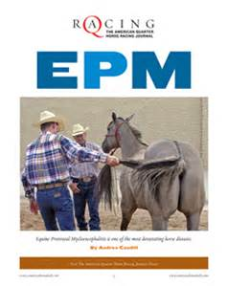
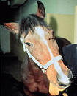
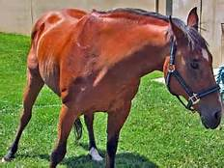
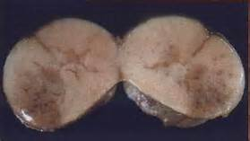
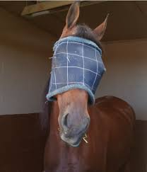
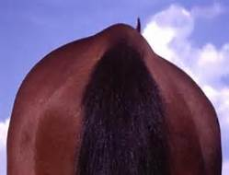
Epm
Equine Protozoal Myelopathy

Slide 3
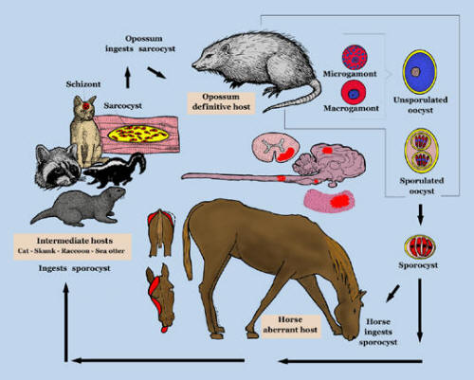
EPM life cycle

Slide 4
3 A’s-Ataxia, atrophy, asymmetry
Clinical Signs: Body
Facial Signs:
*Uncoordinated movement of the hind feet
*Switching leg lameness that comes & goes
*Hind end weakness-worsened on a hill
*Problems balancing if foot is lifted up
*Circling, slipping, falling, leaning
*Droopy Ear
Vision changes
*Problems chewing/swallowing
*Head Tilt

Slide 5
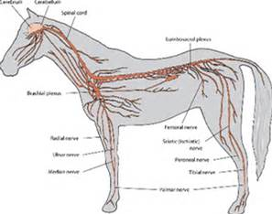
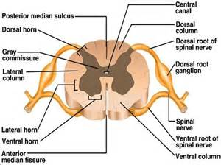
The Great Mimicker

Slide 6
Absent a diagnosis, surgery is trauma, medicine is poison, and alternative medicine is witchcraft
-Unknown
Diagnosis-The Ongoing Challenge

Slide 7
Blood work +/- CSF + Neuro Exam
It is estimated that 50-80% of horses in the US have serologic evidence of exposure to S. neuroma.
<1% (estimated 0.14%) develop EPM
Possible immune system problem?
CSF taps can be contaminated with blood that will affect results
Many options for serology. None are considered “The Gold Standard”.
Only definitive diagnosis is a post mortem examination (necropsy).

Slide 8
Comparison of serologic tests
SAG ELISA (2,3,4)
IFAT
Considered the most accurate test currently available
Surface proteins that are specific to S. neuroma
Can pull 2 sample 2-4 weeks apart. If active disease, you will see a 2-4 X increase in numbers.
UC Davis (NeoFluor, SarcoFluor)
Cross reacts with non-pathogenic protozoa
High false + rate

Slide 9
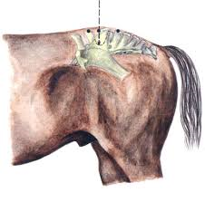
Comparison of serologic tests
Western Blot
PCR
Oldest available test
Read by humans (Prone to error)
Only helpful if negative
Looking for protozoal DNA
Can’t differentiate live or dead protozoa
High false negative rate

Slide 10
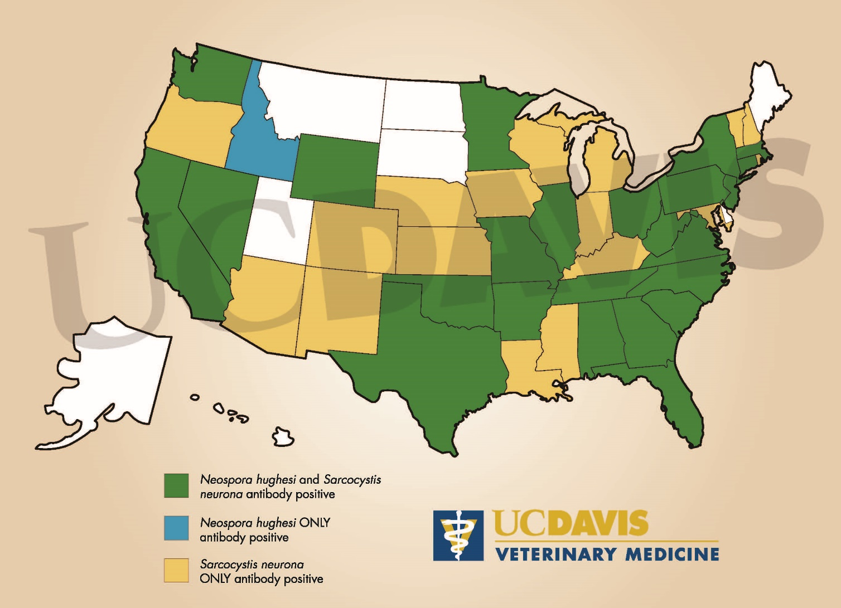
Epm seroprevalence

Slide 11
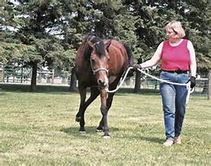
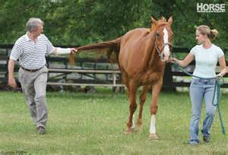
The importance of the neurological exam
Treat for EPM but look for other diagnoses.
A response to treatment is NOT considered diagnostic!
Serial examinations allow for the monitoring of response to treatment.

Slide 12
What does EPM look Like?
(Pardon the interruption as I pull up some video)
Video Footage courtesy of Dr. Amy Johnson – New Bolton Center

Slide 13
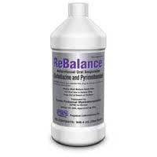

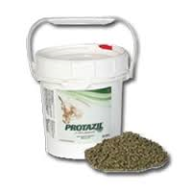
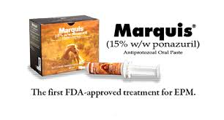
Treatment options
FDA APPROVED
CLINICAL TRIAL
Marquis
Protazil
Rebalance
Oriquin-10

Slide 14
Treatment Notes
Treatment with Marquis & Protazil typically lasted 1-2 months (or 1 month past plateau of improvement)
Rebalance treatment duration closer to 3-6 months
Supportive treatment with NSAIDS, vitamin E, immunomodulators
Oriquin-10: in field trial since May 2011. No data available (Compounded product)
All FDA approved treatments carry an approximate success rate of 60%*
Relapse rate 10-28%* within 3 years
Complete resolution of clinical signs in 55-60% of cases*
*source: Ohio State University

Slide 15
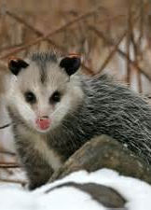
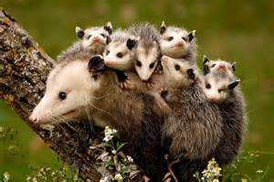
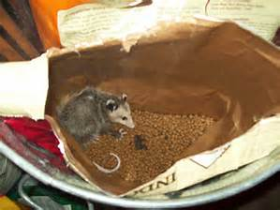
Prevention of epm
*No vaccination currently available
*Horses aged 1-6 years are highest risk
*Limit stress
*Opossum control

Slide 16
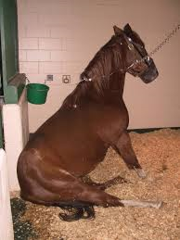
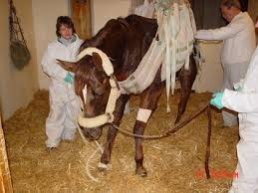
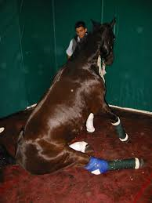
Neurologic Herpes Virus
What Every Owner Should know

Slide 17
Doylestown EHV situation
1-30-2016
Farm blow-by-blow:
12-12-15: Horse from farm traveled to competition in NJ
12-21-15: Neurologic signs noted in 2 horse
12-22-15: 3rd horse with neuro signs noted. All 3 horses euthanized. PA Dept of Ag quarantines farm.
12-24-15: Necropsy findings confirm EHV-1.
12-24-15: 2 additional horses develop fevers.
12-25-15: 4 horses in risk zone develop fevers.
12-27-15: 2 more horses develop fevers.
1-8-15: 2 previously febrile horses develop mild neurologic signs.

Slide 18
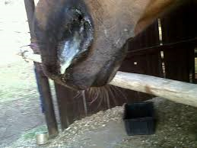
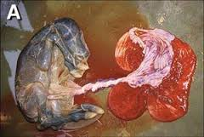
Herpes virus in the horse
Type 1/4
Neurologic Herpes
Respiratory disease
Abortion
Type 4 has caused 1 case of neurological disease
Vaccination available
Caused by a mutated EHV 1 virus
No vaccination available

Slide 19
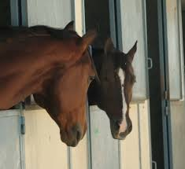
Risk factors for infection
Stress
Boarding Facility
Race tracks
Horse Shows
Pregnant mares
Vaccination?

Slide 20
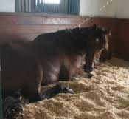
What are the clinical signs of neuropathogenic EHV1?
*Hindend Weakness
*Toe Dragging
*Dog Sitting
*Urinary/Fecal Incontinence
**Most horses will experience respiratory signs 1-2 weeks prior to neurologic signs

Slide 21
What does a horse look like with a EHV-1 Neuro strain infection?
Please wait while I load a video (courtesy of Dr. Amy Johnson at New Bolton Center).

Slide 22
How will the diagnosis be confirmed?
*Detection of the virus from a nasal swab or from blood cells (PCR)
*Similar tests can be ran on any aborted tissues from a pregnant mare
*Most useful in an outbreak situation

Slide 23
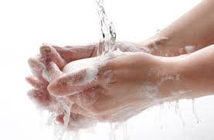
How is the virus transmitted?
Transmission occurs via the respiratory route from coughing and snorting horses.
Shedding can occur for 14 days.
Contaminated hands and equipment can spread the virus.
Mares that abort can spread the virus from aborted tissues and via the respiratory tract.
The virus can survive in the environment for weeks.
Horses can be asymptomatic shedders of virus.

Slide 24
Treatment
*Supportive care
*Antiviral medications-$
*Anti-inflammatories
*Fluids
*Slings
**Horses that remain standing have a good prognosis, although recovery will take weeks to months. Horses that go down have a poor prognosis
.

Slide 25
Prevention
*No vaccination available for the neurologic strain.
*Vaccination against EHV-1 MAY decrease shedding of the virus.
*BIOSECURITY is the most important aspect of prevention.

Slide 26
Biosecurity keys
Horse Traffic
Human side
New arrivals/horses coming in from a show should be isolated for 21 days.
Temperatures should be taken 2 times daily.
Do not share equipment between horses.
Limit horse to horse contact between horses.
Do not house pregnant mares with show horses.
WASH YOUR HANDS!!!!!
Hand sanitizer is great!
Consider foot bathes
Bleach at 1:10 dilution is adequate to kill the virus.

Slide 27
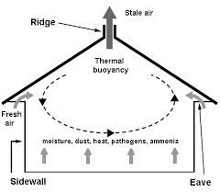
Why isolation does not mean the end of the aisle!!

Slide 28
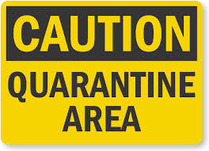
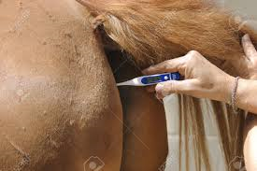
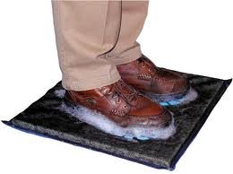
What to do if you suspect an Ehv-1 infection
Isolate the affected horse immediately
Call your veterinarian
Stop all horse traffic on and off the farm
Limit human traffic onto the farm
Disinfect!
Buy lots of hand sanitizer!

Slide 29
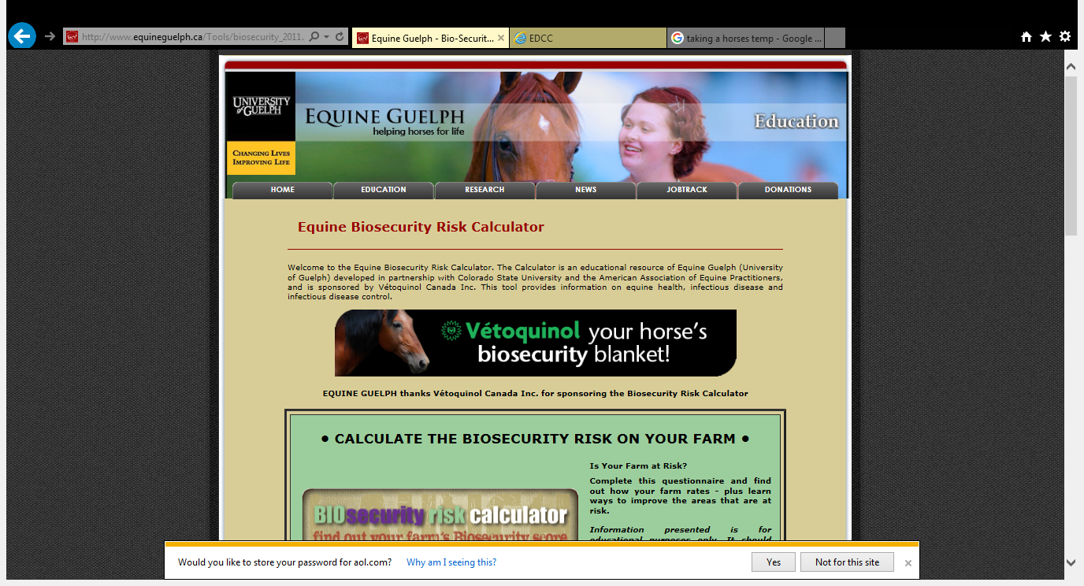
Biosecurity Calculator

Slide 30
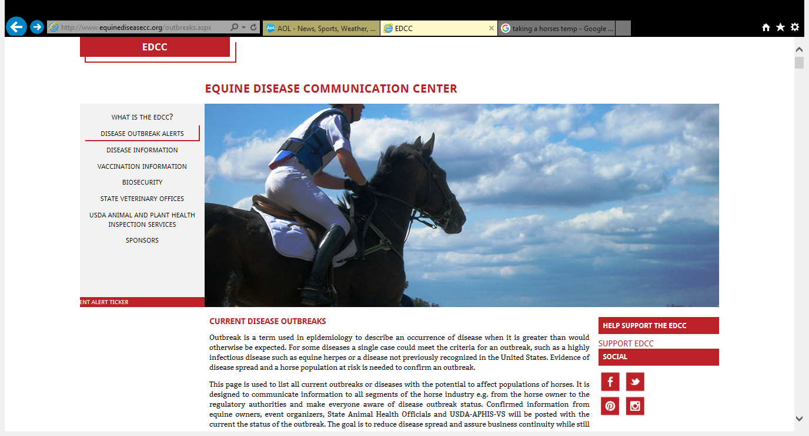
Stay informed on outbreaks

Slide 31
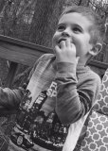
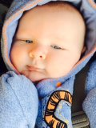
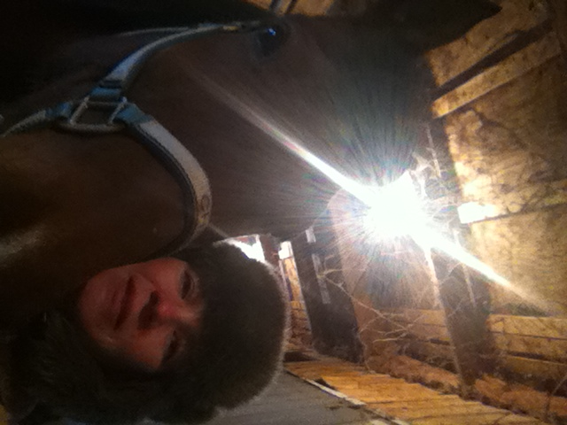
Thank you for the opportunity to speak to you!

Slide 32

Contact Information
Tera Ramig DVM
All Points Equine LLC
610.351.1404
drtera@allpointsequine.com
www.allpointsequine.com

